Slide 1
Stress Management
PE 10 Health

Slide 2
What the $#@!?
How stressed are you?
Stand in the corner that reflects your stress level
1-2-3-4

Slide 3
What is the cause?
Health
Arthritis.
Poor hearing/vision.
Headaches.
Illness, injury, diseases.
Medication problems.
Impaired mobility.
Obesity.
Chronic pain.
Sleep disorders
Work
Downsizing
Commute.
Being fired/laid off.
Unpleasant work environment.
Static position.
Increased responsibilities.
Retirement.
Promotion.
New job.
Inadequate training.
Boss/co-workers.
Little recognition.
Excessive workload.
Family
Arguments.
Discussion
Communication.
Elder care.
Illness, injury, surgery.
Move.
Parenting.
Divorce
Pregnancy.
Adoption.
Sexual problems.
In-law problems.
Substance abuse.
Financial
Change in financial status.
Fixed income.
Paying alimony.
Filing bankruptcy.
Taxes.
Debt.
Retirement income.
Environmental
Noise.
Crime.
Pollution.
Overcrowding.
Traffic.
Weather.
Daily
Child care.
Car trouble.
Household duties.
Losing/forgetting something.
Oversleeping.
Traffic jams.
Waiting.
Cooking.

Slide 4
Effects of stress
What happens to you and your body?

Slide 5
Coping with Stress
Healthy Strategies
Plenty of sleep
Time for yourself
Meditate
Work out
Play video games
Listen to music
Eat healthy
Drink water
Talk to friends
Watch a movie
Spend time with a pet
Take a bath or shower
Focus on the good things
Use a positive affirmation
Watch a funny YouTube
Set realistic goals
Ask for help
Manage your time
Be organized
Spend time with others

Slide 6
Coping with stress
Unhealthy Strategies
Drugs or alcohol
Unhealthy food
Caffeine
Smoking
Venting
Bottling up your emotions
Physical violence
Taking it out on others
Not being able to say no

Slide 7
Help me!?
How can stress be helpful?
How can stress make you better?

Slide 8
Get Help
Websites
keltymentalhealth.ca
kidshelpphone.ca or 1-888-668-6868
help4me.ca
calgaryconnecteen.com
youthsmart.ca
cmha.ca/highschool/studentsH.htm
rightbyyou.ca
211.ca
mindyourmind.ca
7cupsoftea.com
jack.org
Phone Numbers
Kids Help Phone: 1-800-668-6868
Rural Distress Line: 1-800-232-7288
Suicide Crisis Hotline: 1-800-448-3000
Bullying Helpline: 1-888-456-2323
Mental Health Helpline: 1-877-303-2642
Child Abuse Hotline: 1-800-387-KIDS (5437)
Addictions Helpline: 1-866-332-2322
Health Link: 811

Slide 9
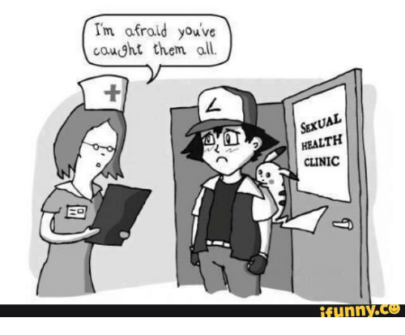
Next Class
November 23th
Sexual Health
Guest Speaker
UBC CAPSI

