Slide 1
Relationships
PE 10 Health

Slide 2
Between Who?
Who do we have relationships with?
Family
Friends
Partners
Teachers
Teammates
Coaches
Peers
Colleagues
Animals
Almost anyone who we interact with on a regular basis…

Slide 3
Healthy vs. unhealthy
Think of the best relationship in your life
Who was it with? What qualities come to mind?
Think of the worst relationship you’ve been in
Who was it with? What qualities come to mind?

Slide 4
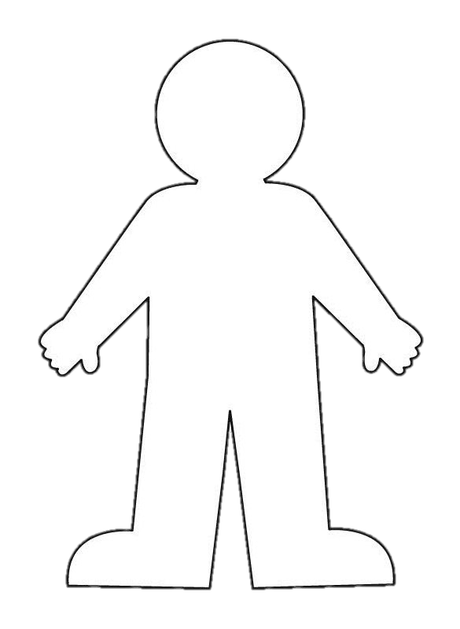
Draw a Healthy Relationship
Draw an outline of a body
Write qualities of a relationship or potential partner
Positive qualities inside the body
Negative qualities outside the body
_
+
_
+
+
_
_
+
+
_
_

Slide 5
Healthy Qualities
Honest
Kind
Caring
Fair
Compassionate
Assertive
Easy going
Respectful
Common interests
Good Listener
Cheerful
Fun to be with
Supportive
Helpful
Loyal
Trustworthy
Dependable
Good boundaries
Intelligent

Slide 6
Unhealthy qualities
Jealousy
Manipulation
Threats
Guilt
Lies
Disrespect
Inequality
Isolation
Poor communication
Demands and orders
Controlling behaviors
Punishments
Constant criticism
Fear
Put downs
Name calling
Abuse or violence

Slide 7
Healthy Relationship Quiz
Complete quiz by answering yes or no
Add your score
Read instructions carefully
Read the summary of your score
Reflect
Is your relationship healthy?
Do you need to re-think your relationship?

Slide 8
Healthy Relationship Quiz

Slide 9
Healthy Communication
Speak Up. In a healthy relationship, if something is bothering you, it’s best to talk about it instead of holding it in.
Respect Each Other. Your partner’s wishes and feelings have value, and so do yours. Let your significant other know you are making an effort to keep their ideas in mind. Mutual respect is essential in maintaining healthy relationships.
Compromise. Disagreements are a natural part of healthy relationships, but it’s important that you find a way to compromise if you disagree on something. Try to solve conflicts in a fair and rational way.
Be Supportive. Offer reassurance and encouragement to each other. Also, let your partner know when you need their support. Healthy relationships are about building each other up, not putting each other down.
Respect Each Other’s Privacy. Just because you’re in a relationship doesn’t mean you have to share everything and constantly be together. Healthy relationships require space.

Slide 10
Setting Boundaries
Emotional
Those 3 little words
Space
Physical
Your time not their dime
Digital
When to post
What to post
Photos

Slide 11
LGBTQ2+ Relationships
Respects your chosen gender pronouns or name.
Gives you space to hang out with friends and family without thinking you’re cheating.
Never threatens to out you to people.
Never tells you you’re not a real lesbian, gay man, trans person or whatever you may identify as because you don’t have sex the way they want you to.

Slide 12
What is Consent?
Communication every step of the way
Verbal/Nonverbal
Are you comfortable?
Is this okay?
Do you want to _____?
Pushes away
Sex + Consent = Consensual Sex

Slide 13
What is not Consent?
Ignoring communication between partners
Someone cannot give consent if:
- they are intoxicated (by alcohol or drugs)
- they are asleep
- they are being threatened or are afraid of saying no
Sex – Consent = RAPE

Slide 14
Laws around Consent
The legal age of sexual consent in Canada is 16. However, 14- and 15-year-olds can have sex with someone who is less than five years older.
A 12 or 13-year-old can consent to sexual activity with another young person who is less than two years older and with whom there is no relationship of trust, authority or dependency or other exploitation of the young person.
The age of consent is 18 years where the sexual activity "exploits" the young person -- when it involves prostitution, pornography or occurs in a relationship of authority, trust or dependency (e.g., with a teacher, coach or babysitter).
The age of consent laws apply to all forms of sexual activity, ranging from sexual touching (e.g., kissing) to sexual intercourse.

Slide 15
Next Class…
Tuesday, November 21
Fitness
Change into PE Strip!
If nice, running outside ☺
If raining, running inside ☺
Circuit
Stress Management

Slide 16
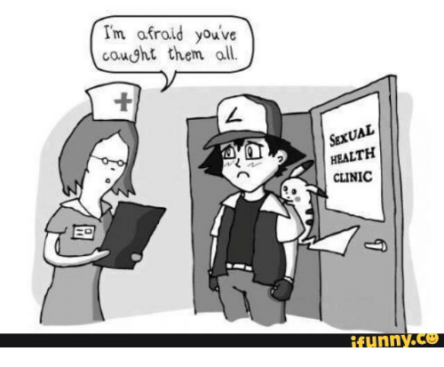
Next Next Class…
November 23th
Sexual Health
Guest Speaker
UBC CAPSI

