Slide 1
HEALTH 9
Lesson 2.2
INFLUENCES ON SUBSTANCE USE AND ADDICTIONS

Slide 2
There are many factors that influence peoples decision to engage in substance use or addictive behaviours
Think of factors that influence people to engage in behaviours of substance use or other addictive behaviours.

Slide 4
There are many factors that influence peoples decision to not engage in substance use or addictive behaviours
Think of factors that influence people to not engage in behaviours of substance use or other addictive behaviours.

Slide 6
Substance Use & Related Behaviours Quiz
You will be given a statement… think about if you think it is true,
OR false

Slide 7
Statement # 1
Less than 80% of grade 6 – 9 students in Canada have never tried smoking

Slide 8
TRUE
78.5% of grade 6 – 9 students have tried smoking.

Slide 9
Statement #2
Less than 50% of Canadian youth aged 15 – 19 reported drinking alcohol in the past year.

Slide 10
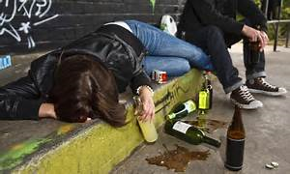
FALSE
60% of youth reported drinking alcohol in the past year.

Slide 11
Statement #3
Approximately 30% of youth in Canada report drinking 5 or more drinks on one occasion (binge drinking).

Slide 12
TRUE

Slide 13
Statement #4
The most commonly used illegal drug among Canadian youth is marijuana. (it is still illegal for youth)

Slide 14
TRUE

Slide 15
Statement #5
Approximately 75% of marijuana tested by the Port Moody Police was laced with another illegal substance like methamphetamine, cocaine, fentanyl, heroine, etc.

Slide 16
FALSE
86% of marijuana tested by the Port Moody Police contained another illegal substance.

Slide 17
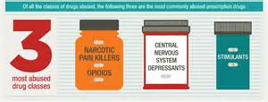
Statement #6
More than 5% of Canadian students in Gr. 7 – 12 reported using at least one prescription pharmaceutical to get high.

Slide 18
FALSE
Approximately 4% reported using at least one prescription pharmaceutical to get high.

Slide 19
Statement #7
8 – 18 year old Canadian youth spend an average of 42 hours per week using social media versus 9 hours exercising.

Slide 20
TRUE

Slide 21
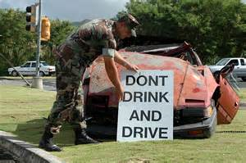
Statement #8
In less than 45% of motor vehicle crashes among 16 – 25 year old Canadians, drugs and/or alcohol have been a factor.

Slide 22
FALSE
Motor vehicle crashes are the leading cause of death among 16 – 25 year olds, and alcohol and/or drugs are a factor in 55% of those crashes.

Slide 23
Statement #9
In Canada, less than 5% of drivers involved in alcohol-related serious injury crashes were between the ages of 16 and 19.

Slide 24
FALSE
11.3% of drivers involved in alcohol related serious injury crashes were between the ages of 16 and 19.

Slide 25
Statement #10
1 in 4 sexually active Canadians aged 14 – 19 will contract a sexually transmitted disease within one year.

Slide 26
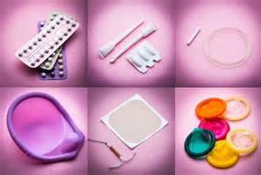
TRUE

