Slide 1
RESILIENCE

Slide 2
WHAT IS RESILIENCE?
What does it mean to be resilient?

Slide 3
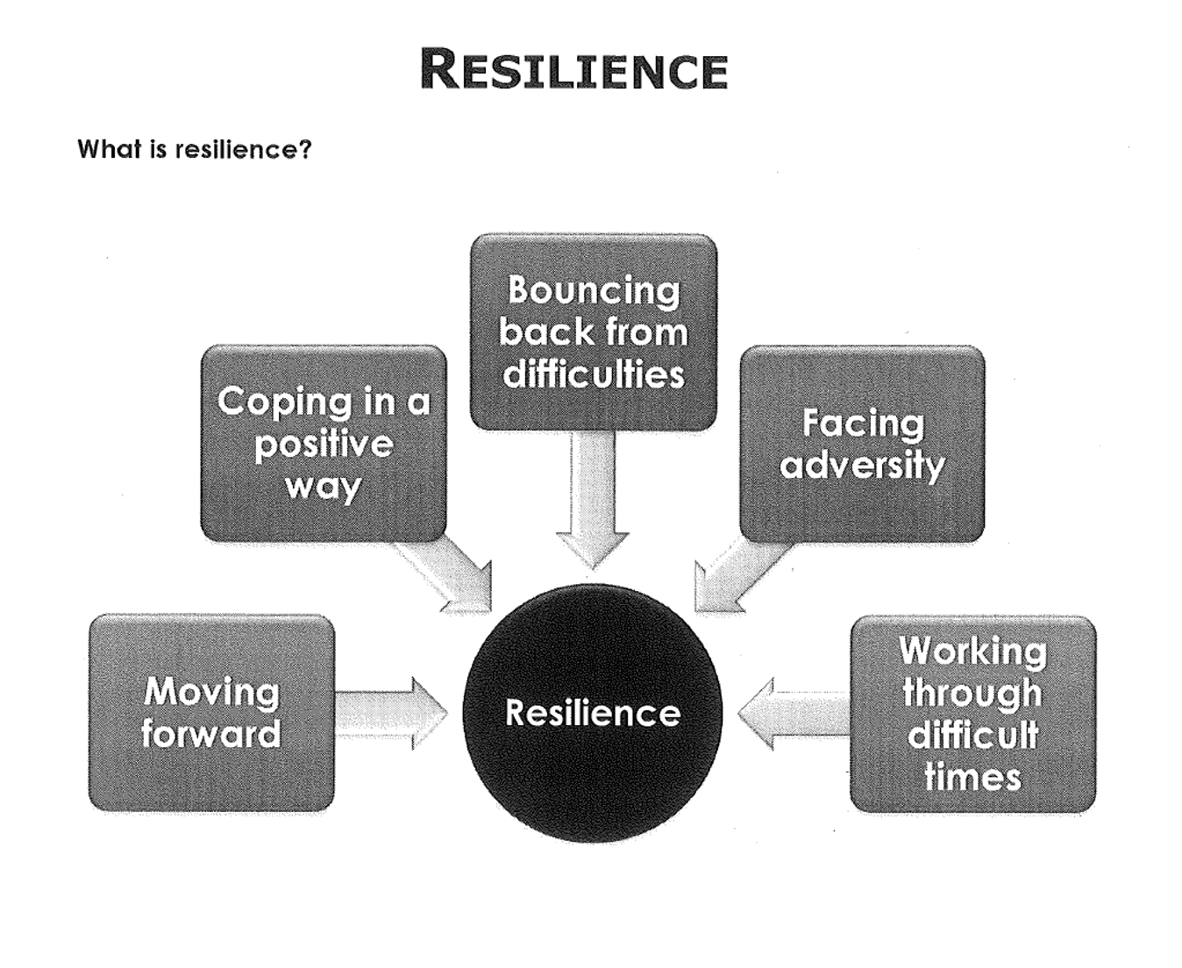
What is ?

Slide 4
PROTECTIVE FACTORS
Protective Factors
  Help to strengthen our resilience.
  Protect us from difficult situations.
  If we build up Protective Factors we build up our resilience as well.
  Example:
  Having a supportive family helps us to be more resilient.
  What other Protective Factors can you think of???

Slide 5
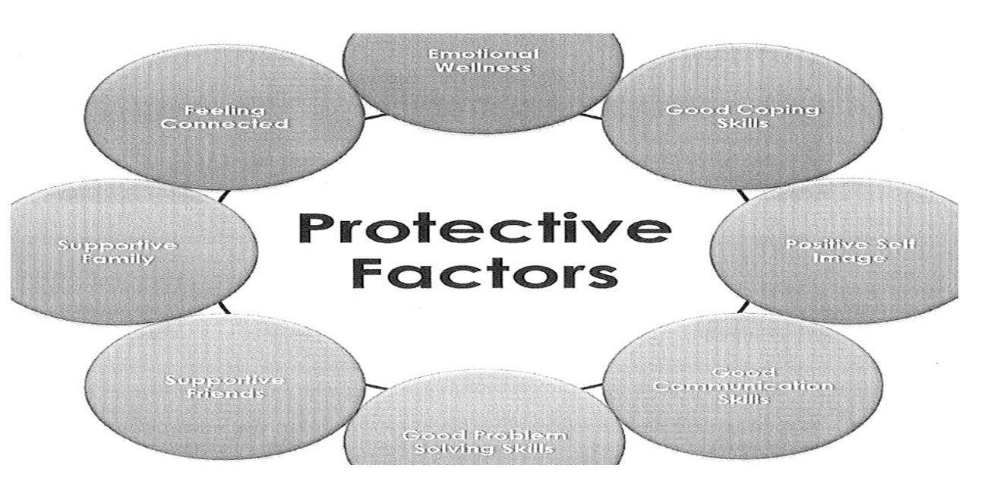
PROTECTIVE FACTORS
Emotional Wellness
Feeling Connected
Good Coping Skills
Supportive Family
Positive Self Image
Good Communication Skills
Supportive Friends
Good Problem Solving Skills

Slide 6
RISK FACTORS
Risk Factors:
  Break down our resilience.
  May cause us difficulties for a person.
  May make a person more susceptible to substance use.
  Example: If feeling connected to others increases our resilience, feeling disconnected may be a risk factor.
  What Risk Factors can you think of???

Slide 7
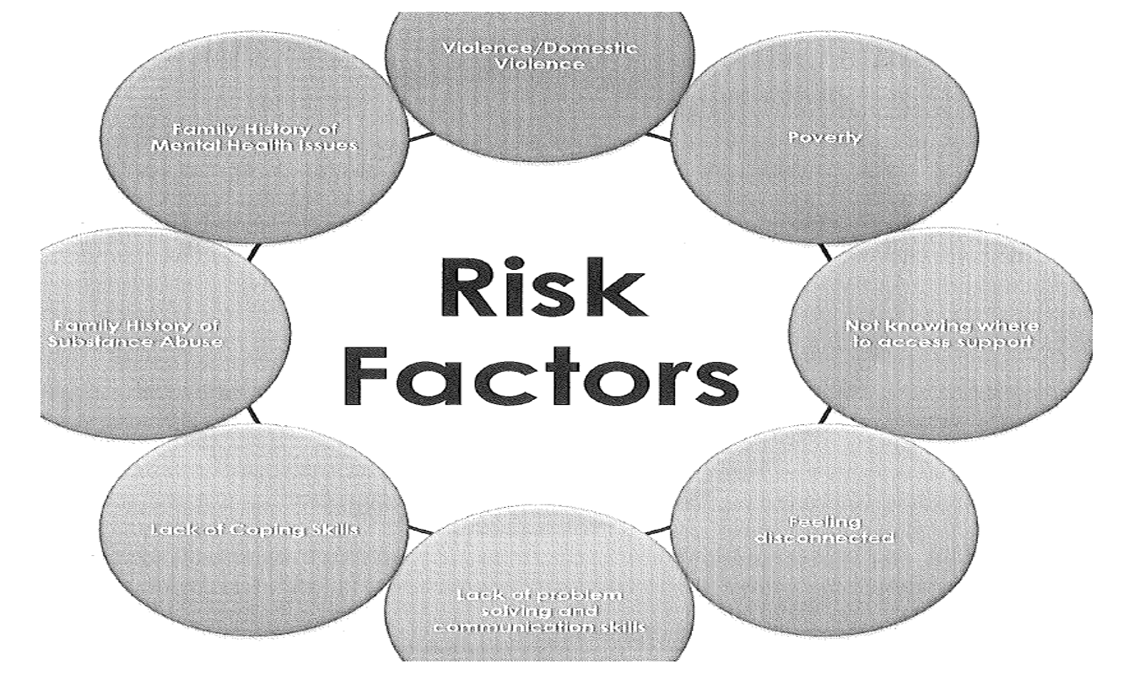
RISK FACTORS
Violence/ Domestic Violence
Family History of Mental Health Issues
Poverty
Family History of Substance Abuse
Not Knowing Where To Access Support
Lack of Coping Skills
Feeling Disconnected
Lack of Problem Solving and Communication Skills

Slide 8
How do protective and risk factors affect our choices?
EXIT:
What is one area of protective factors that you could work on in your own life?

